Slide 1
COGNITIVE BIAS, THE “ELEPHANT IN THE LIVING ROOM” OF SCIENCE AND PROFESSIONALISM
Peter R. Rose, Ph. D
Rose & Associates, LLP
AAPG Distinguished Lecturer, 2015-17

Slide 2
COGNITIVE BIAS:
Inherent thinking errors made in acquiring and processing information … preventing us from accurately grasping reality, even if confronted with the data needed to form an accurate view.

Slide 3
INSTRUCTIONS:
Without discussing it with anyone nearby, write down what you see on the next slide _____________

Slide 4
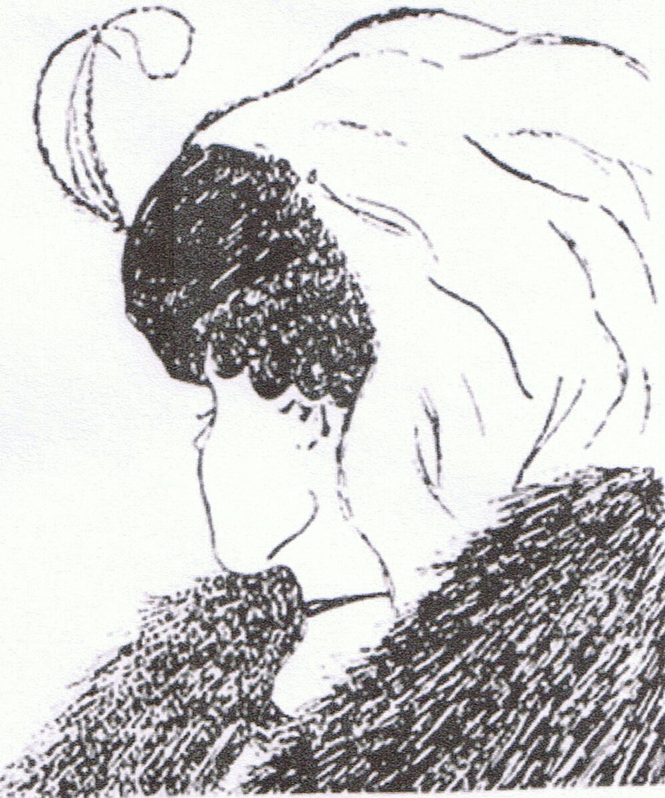

Slide 5
QUESTION:
If you saw a young woman, please hold up your hand ____

Slide 6
QUESTION:
If you saw an old woman, please hold up your hand ____

Slide 9
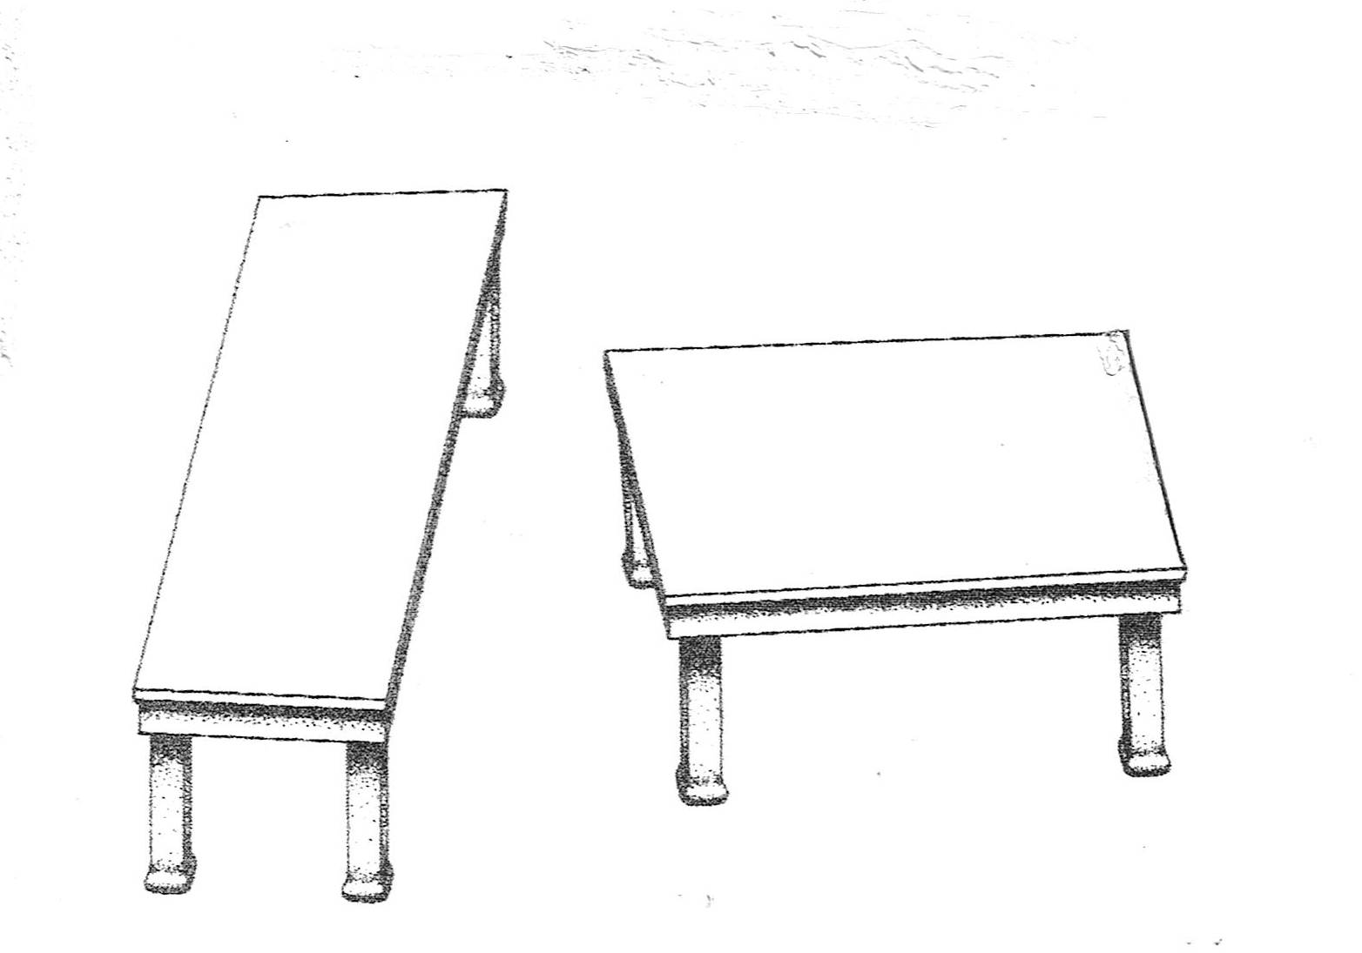

Slide 10
QUESTION:
Which table is longest, the one on the left or the one on the right?
Write your answer down _______

Slide 12
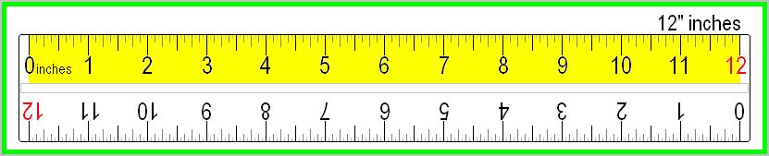

Slide 13
OPTICAL ILLUSIONS:
TWO TYPES --
Conceptual
Dimensional/Testable

Slide 14
COGNITIVE BIAS:
Inherent thinking errors made in acquiring and processing information … preventing us from accurately grasping reality, even if confronted with needed data to form an accurate view.
Analogous to optical illusions – the error remains compelling even if one is fully aware of reality.
Intrinsic to human thought, so any system of acquiring knowledge to describe reality must include mechanisms to control for bias.
May result from holding to one’s preferences and beliefs regardless of contrary information
Just knowing about common biases doesn’t guarantee that you are free from them.

Slide 15
WHY IS THIS IMPORTANT?
We depend upon modern Science to address and assess issues affecting the well-being of our Society. So it is essential that scientific results be as objective – free from Bias – as possible.
Accumulating research results show that Cognitive Bias is much more common in Science and Industry than previously realized -- and often not even examined-for.
Recent experience within the E&P sector has provided methods and experience for detecting and correcting Cognitive Bias that may be useful to other branches of Science.

Slide 16
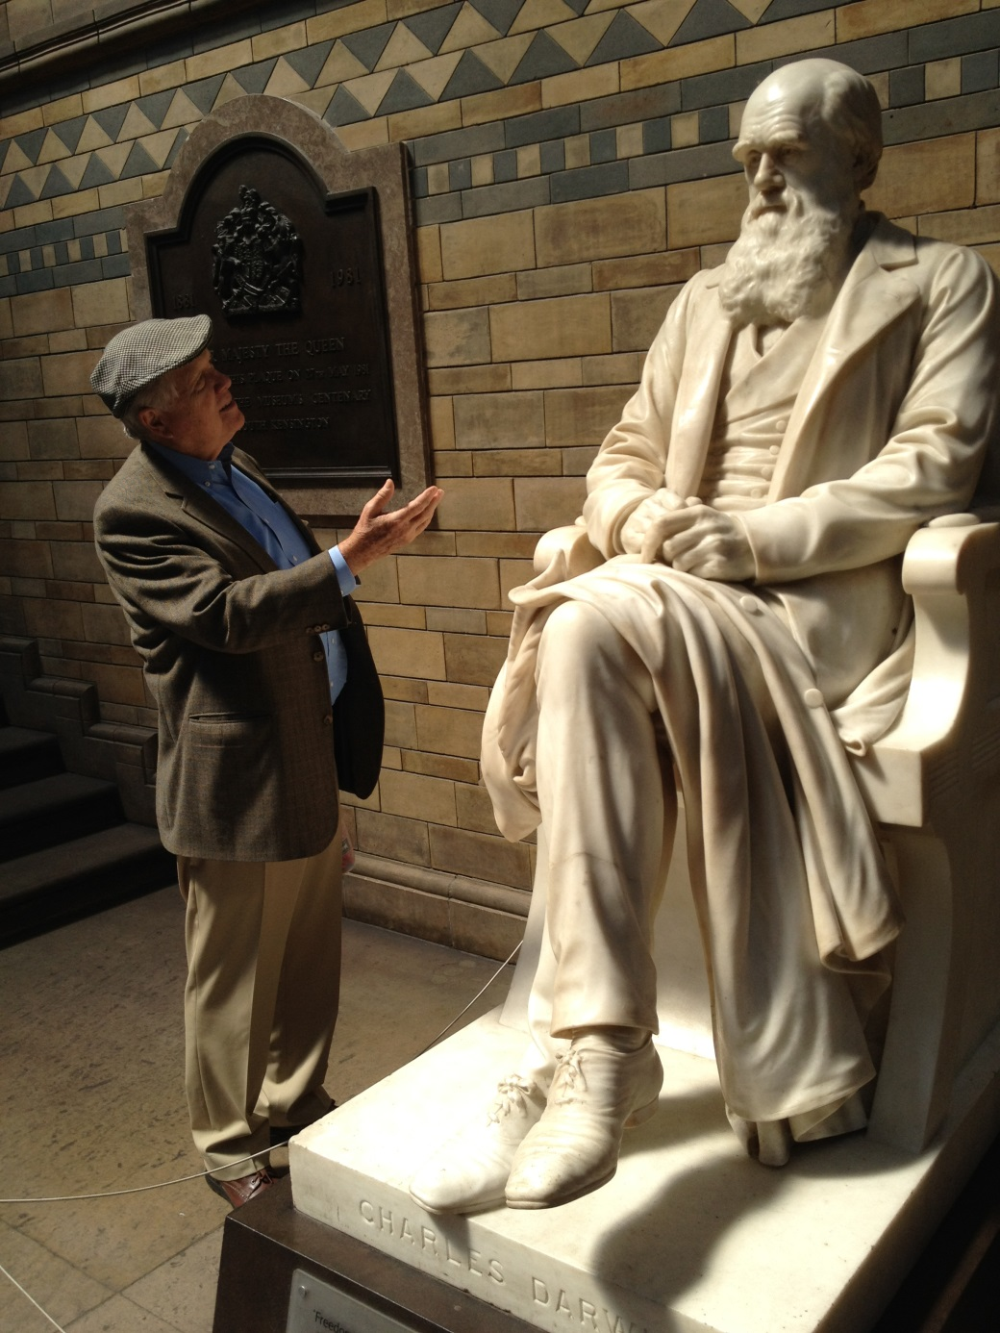
Public Regard for Objectivity of Science
Geoscience in PETROLEUM E&P

Slide 17
TASKS FOR E&P GEOSCIENTISTS
Find Prospects
Measure Them Objectively
  EUR ➔ Profitability (if Success)
  Chance of Success
Communicate Objectively

Slide 18
PROBLEM: TECHNICAL OBJECTIVITY IN E&P GEOSCIENCE
UNCERTAINTY,
COMMERCIAL PRESSURES & SELF-INTEREST
SCIENTIFIC & GEOTECHNICAL RESULTS
BIAS
UNDER-PERFORMING PROJECTS!

Slide 19
GLOBAL DEEPWATER TARGETS
Predictive Accuracy = 45%
“As with most exploration companies, BP has tended to. . . overestimate the potential discovery volumes prior to drilling -- this trend is even more pronounced for deep water prospects [where] volume estimation. . . remains significantly poorer than expected.”
Francis Harper (BP) 1999
VOLUMES FROM ALL DISCOVERIES
Predicted
Actual
0
25
50
75
100
125
SEQUENCE OF TARGETS DRILLED
Harper 1999

Slide 20
Sequential Accumulation Plots
Help Track Program Performance
After Clapp and Stibolt, 1991
Notes:
No changes
Note the actual cumulative resource adds are consistently outside the predicted range of outcomes on a cumulative basis. This is a typical result and action should be taken to correct this bias. The estimation process needs to recognize a significant downside not being included in the pre-drill ranges.

Slide 21
COMMON COGNITIVE BIASES IN E&P
Confirmation Bias: Ignoring Data that Don’t Fit Our Theories
Overconfidence: Predictive Ranges are Too Narrow
False Analogs: Unrepresentative models
Anchoring: First Estimates bias Final Estimates
Motivational Bias: Self-interest Influences Estimates

Slide 22
E&P COGNITIVE BIAS
COMMON CAUSES --
Premature identification of “The Answer”
Personal Hubris/Arrogance
No consistent system for Project Assessment
Lack of Perspective
Lack of Imagination
Laziness
Excessive Personal Self-interest
Unrealistic limitations of Time and Budget
Inadequate comparison of Risk vs. Reward
No Post-audits
Faulty Reward System: Activity vs. Results

Slide 23
BIGGEST CHALLENGE:
  Convincing Educated Technical & Management Professionals that THEY are subject to Cognitive Bias . . . . .
. . . JUST LIKE EVERYONE ELSE!

Slide 24
EXERCISE

Slide 25
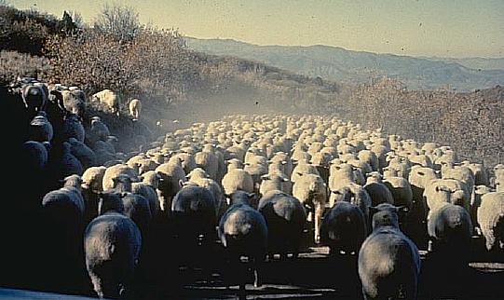

Slide 26
How Many Sheep Are There?

Slide 27
ESTIMATING WITH PROBABILISTIC RANGES
SMALL CHANCE
THE OUTCOME IS MORE
THAN P10 VALUE
P1
P2
P5
P10
P20
P30
P40
80 % Confidence Interval
P50
P60
P70
P80
P90
LARGE CHANCE
THE OUTCOME IS MORE
THAN P90 VALUE
P95
P98
1
10
100
1000
P99
NUMBER OF SHEEP

Slide 28
Write down P90 and P10 estimates for the flock of sheep:
P90 = ___ > low number
P10 = ___ > high number

Slide 31
UNCERTAINTY:
IF YOUR RANGE INCLUDED 175
. . . . HOLD UP YOUR HAND!

Slide 32
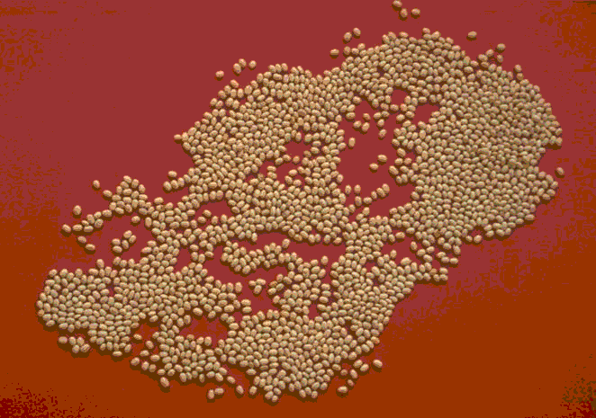
Notes:
1780

Slide 33
How Many Beans Are There?

Slide 34
ESTIMATING WITH PROBABILISTIC RANGES
SMALL CHANCE
THE OUTCOME IS MORE
THAN P10 VALUE
P1
P2
P5
P10
P20
P30
P40
80 % Confidence Interval
P50
P60
P70
P80
P90
LARGE CHANCE
THE OUTCOME IS MORE
THAN P90 VALUE
P95
P98
1
10
100
1000
P99
NUMBER OF BEANS

Slide 35
Write down P90 and P10 estimates for the following bean slide:
P90 = ______
P10 = ______

Slide 36
Notes:
1780

Slide 37
Write down P90 and P10 estimates for the previous bean slide:
P90 = ______
P10 = ______

Slide 39
If your P90 – P10 Range Includes
1780
!
PLEASE RAISE YOUR HAND

Slide 40
TESTING FOR BIAS:
What % of Audience had a P90-P10 range that included 1780 (=80% Confidence)??
OVERCONFIDENCE = RANGES TOO NARROW
  Test for Conservative vs. Optimistic
How many had range lower than 1780?
How many had range higher than 1780?
MESSAGE:
ESTIMATING BIAS IS ENDEMIC !

Slide 41
209
Notes:
1780

Slide 42
CHARACTERISTICS OF E&P VENTURES:
  High uncertainty
  Technology clarifies, doesn’t eliminate uncertainty
  Prospecting process leads to advocacy
  “Science” reinforces apparent confidence
  Hard to see prospect in detached “repeated-trials” perspective
  Desire not to bring bad news leads to creeping over-optimism

Slide 43
EARLY PRAGMATIC MEASURES FOR REDUCING BIAS IN E&P VENTURES
Reserves Definitions (SEC)
Licensing/Certification of Engineers and Geologists
Use of Outside Experts
Engineers (“Conservative”) vs. Geologists (“Optimistic”)
Individual Rules of Thumb (esp. Executives!)
Informal Endorsements of Dependable Operators and Experts
Threat of Lawsuits and Public Exposure
Underlying Causes & Remedies of Bias Not Addressed!

Slide 44
HOW TO MINIMIZE E&P BIAS:
Reality & Plausibility Checks
Multiple Working Hypotheses
Probabilistic Estimating
Fitting E&P Parameters to Lognormal Expectation
Employing Group Wisdom
Managing E&P as a Portfolio
Performance-tracking of Previous Ventures

Slide 45
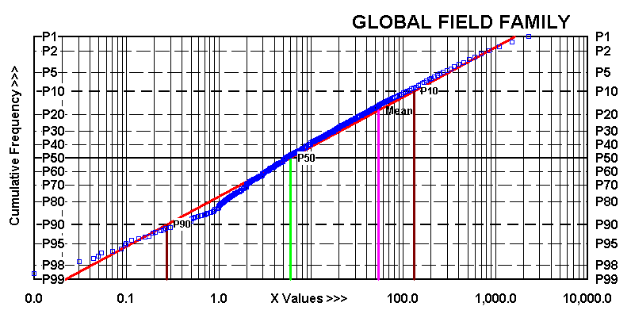
PROCESS FOR REALITY CHECKS
GLOBAL FIELD POPULATION (n ~30,000)*
*Every 100th field plotted
MMBOE
P99 = 0.018
P90 = 0.250
P50 = 5.40
P10 = 143
P1 = 1917
MEAN = 53
0.1
1
10
100
1000 MBOE
Source: NRG, IHS

Slide 46
PROCESS FOR REALITY CHECKS
Exploration prospects should be
characterized by broad ranges and
appropriate P99 values
P1
P2
P5
Development prospect
P10
P20
P30
P40
Appropriate
exploration
prospect
P50
P60
P70
Inappropriate
exploration
prospect
P80
P90
P95
P98
P99
0.01
.10
1
10
100
1000
Prospect EUR, MMBOE

Slide 47

PRE-DRILL PROJECT RESOURCE EURs:
MOST COMMON CAUSE OF PROJECT EUR OVERESTIMATES --
LOW-SIDE (P99) ESTIMATES
Too High !

Slide 48
MULTIPLE WORKING HYPOTHESES
Pursued Simultaneously, None Championed
Helps Pinpoint Critical Elements Common to All Possible Scenarios
Promotes Thoroughness
Requires Discipline and Imagination
Allows Later Adjustments
What are the
alternative
scenarios?
Make more
than one map !
Chamberlain, 1931

Slide 49
ESTIMATING WITH PROBABILISTIC RANGES
SMALL CHANCE
THE OUTCOME IS MORE
THAN P10 VALUE
P1
P2
P5
P10
P20
P30
P40
80 % Confidence Interval
P50
P60
P70
P80
P90
LARGE CHANCE
THE OUTCOME IS MORE
THAN P90 VALUE
P95
P98
1
10
100
1000
10K
P99
100K

Slide 50
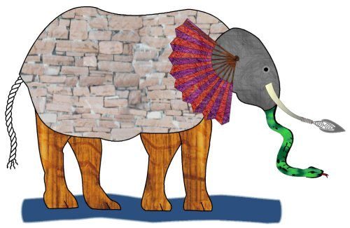
GROUP WISDOM: Independent Multiple Estimates
John Godfrey Saxe's (1816-1887)
version of the famous Indian legend
Notes:
It was six men of Indostan To learning much inclined, who went to see the Elephant (Though all of them were blind), that each by observation Might satisfy his mind.
The First approached the Elephant, and happening to fall Against his broad and sturdy side. At once began to bawl: "God bless me! but the Elephant Is very like a wall!"
The Second, feeling of the tusk Cried, "Ho! what have we here, So very round and smooth and sharp? To me `tis mighty clear This wonder of an Elephant Is very like a spear!"
The Third approached the animal. And happening to take. The squirming trunk within his hands. Thus boldly up he spake: "I see," quoth he, "the Elephant Is very like a snake!"
The Fourth reached out an eager hand And felt about the knee :"What most this wondrous beast is like is mighty plain," quoth he;"‘ Tis clear enough the Elephant is very like a tree!"
The Fifth, who chanced to touch the ear ,Said: "E'en the blindest man Can tell what this resembles most; Deny the fact who can ,This marvel of an Elephant Is very like a fan!"
The Sixth no sooner had begun About the beast to grope, Than, seizing on the swinging tail
That fell within his scope."I see," quoth he, "the Elephant Is very like a rope!"
And so these men of Indostan Disputed loud and long ,Each in his own opinion
Exceeding stiff and strong ,Though each was partly in the right, And all were in the wrong!
Moral:
So oft in the logic wars, The disputants, I ween, Rail on in utter ignorance
Of what each other mean, And prate about an Elephant Not one of them has seen!

Slide 51
DO RISK ANALYSIS SYSTEMS REALLY WORK?
PERCENT OF DISCOVERIES AT FORECAST PERCENTILE RANGE
40
Mobil
Guidelines followed
n = 26
30
20
10
P80
P60
P40
P20
40
Guidelines not
Followed; n = 28
30
20
10
Citron, Cook, and Rose, 2002

Slide 52
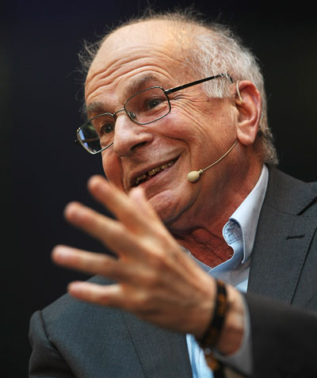
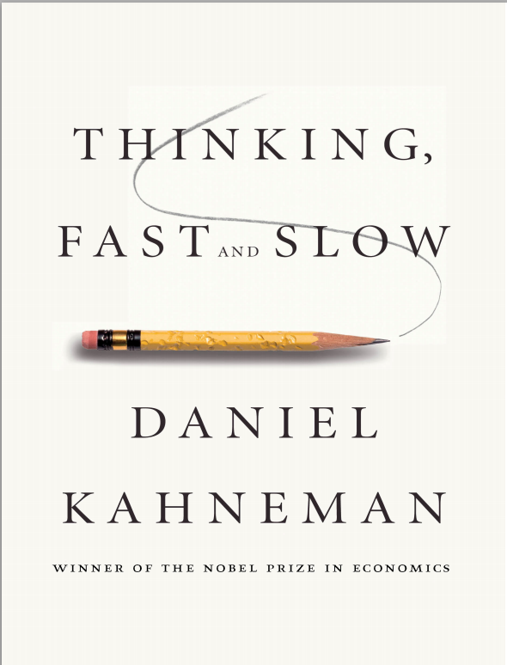
THE ULTIMATE AUTHORITY
SYSTEM 1 (FAST)
uses association and metaphor to produce a quick and dirty draft of reality.
SYSTEM 2 (SLOW) thinks deliberately and rationally, arriving at reasoned choices.
But SYSTEM 2 tires easily and often accepts the unreliable story about the world that System 1 feeds it.
Does this all go back to Plato vs. Aristotle?

Slide 53
OPTICAL ILLUSIONS:
TWO TYPES --
Conceptual
Dimensional/Testable

Slide 54
Cognitive Biases
Two Primary decision-making processes
  SYSTEM 1: operates automatically, quickly, with little or no effort
      Intuitive process. Impulsive, emotional & often unconscious action
      Associated with fight-or-flight response; default option
      “Thinking Fast”
  SYSTEM 2: uses controlled and conscious mental activity
      Invokes critical, deductive and logical thinking
      Requires deliberate effort
      “Thinking Slow”
Notes:
Biases potentially may be evolutionarily beneficial, and hence the reason they persisted. Our natural way of thinking is instinctive, intuitive and often driven by emotions. We have evolved to make quick judgments, and this serves us well in many situations, and hence evolution has persisted this style. For example, pattern recognition. If you think you see the pattern of a tiger in the bushes, 10 false positives is better than one false negative for survival chances.
Note that our biases are not “faults” in our thinking. Rather, they are tools that have evolved to make judgments and decisions and they have persisted because they generally produce correct results.
Critical thinking is unnatural. Our natural instincts work well enough most of the time, but often in an uncertain and complex situation they let us down.

Slide 55
Cognitive Biases
System 1 (Thinking Fast)
  Is in the older part of our brain in evolutionary terms (supports quick decisions that follow our instincts and intuition)
  Receives incoming information before System 2 does
  Is more prone to error (bias) in complex or uncertain situations
  Biases in judgement and decision making are not necessarily detrimental or irrational
System 2 (Thinking Slow)
  In evolutionary terms, is in a more recent part of our brains
  Evolved to manage uncertain situations where System 1 fails
  Using System 2 in decisions or situations of uncertainty can often lead to feeling uncomfortable
  We don’t have time to apply System 2 to all daily decisions
Notes:
Biases potentially may be evolutionarily beneficial, and hence the reason they persisted. Our natural way of thinking is instinctive, intuitive and often driven by emotions. We have evolved to make quick judgments, and this serves us well in many situations, and hence evolution has persisted this style. For example, pattern recognition. If you think you see the pattern of a tiger in the bushes, 10 false positives is better than one false negative for survival chances.
Note that our biases are not “faults” in our thinking. Rather, they are tools that have evolved to make judgments and decisions and they have persisted because they generally produce correct results.
Critical thinking is unnatural. Our natural instincts work well enough most of the time, but often in an uncertain and complex situation they let us down.
For example, loss aversion (a common behavior that economists deem to be irrational) may actually be rational behavior and most likely maintained because of evolutionary benefits (note, people are generally more risk adverse when it comes to gains and risk seeking when it comes to losses

Slide 56
“People will go to almost any length to avoid thinking.”
Ed Capen, 1984

Slide 57
OK, so we have methods for coping with Biases that are Testable / System 2 -- How to deal with Conceptual / System 1 Biases CONSTRUCTIVELY ?
Problem: It does little good for me to tell you that your judgment and opinions are biased.
(The Voice of Bitter Experience: Avoid discussions in Public about POLITICS and RELIGION !)
Solutions:
Maintain respect & communication (Haidt, 2013)
Focus on Process and Decisions
Performance-tracking to provide evidence of Reality

Slide 58
But wait – there’s more to this….
Am I as Biased as You?
Emily Pronin, et al. (2004): Objectivity in the eye of the beholder: Divergent Perceptions of Bias in Self versus others

Slide 59
How We See Ourselves and How We See Others
People see themselves differently from how they see others.
  They are immersed in their own sensations, emotions, and cognitions at the same time that their experience of others is dominated by what can only be observed externally.
This basic asymmetry has broad consequences. It leads
  people to judge themselves and their behaviors differently from how they judge others and those others’ behavior.
Often, those differences produce disagreement and conflict.
  Understanding the psychological basis of those differences may help mitigate some of their negative effects.
PRONIN, ET AL., 2004

Slide 60
EXERCISE: SENSING OUR OWN COGNITIVE BIASES BY DISCERNING THEM IN OTHERS --
      “GMFs are too Dangerous” : Agree? _______ ; Don’t know? ___ ; Disagree?____
      “Vaccinating Kids is too Dangerous”: Agree? ___; Don’t know? ___; Disagree? ___
      “Man-made Global Climate Change is too Dangerous”: Agree? __; Don’t know ?___; Disagree? ___
      QUESTION A: IF YOU THINK OTHERS’ ANSWERS SHOW BIAS, DO YOU THINK YOURS COULD TOO?
      QUESTION B: SOURCES OF YOUR INFO? MANY & DIVERSE? ________; FEW & UNIFORM? _______

Slide 61
BACK TO SCIENCE:
WHY IS ALL THIS IMPORTANT?
Most Scientists recognize the existence and operation of Cognitive Biases much more in other Scientists than in themselves. Private-sector Scientists have ways to cope.
Many Public-sector Scientists recognize the existence of Cognitive Bias in scientific work theoretically, but very few practice active measures to control it in their own work.
Is this because there is little or no penalty (or timely reputational consequence) for erroneous conclusions?
Is this an Accountability issue?

Slide 62
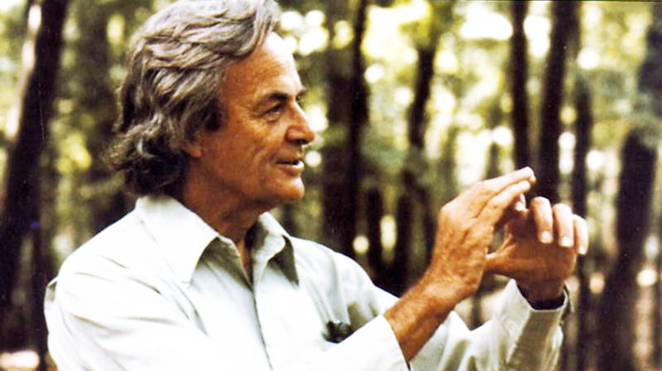
FEYNMAN ON COGNITIVE BIAS:
“ The first principle is that you must not fool yourself – and you are the easiest person to fool”.
Dedicated practice of the Scientific Method is Key: “. . . a kind of scientific integrity, a principle of scientific thought that corresponds to a kind of utter honesty -- a kind of leaning over backwards.”
-- RICHARD FEYNMAN (1918-1988) NOBEL LAUREATE (1965).

Slide 63
AMERICAN FOLK HUMOR: “Everybody talks about the weather, but nobody does anything about it. (MARK TWAIN )
WESTERN SCIENCE VERSION: “Everybody talks about cognitive bias, but nobody does anything about it.”
. . . BUT MANY E&P GEOSCIENTISTS & ENGINEERS DO SO, ROUTINELY !
PROBLEM – How to transfer the E&P experience in coping with Cognitive Bias to WESTERN SCIENCE ?

Slide 64
MOTIVATIONAL BIAS – REAL LIFE EXAMPLES
“Who wants to hear actors talk?” H.M. Warner, Warner Brothers (1927).
“Television won’t last because people will soon get tired of staring at a plywood box every night.” Darryl Zanuck, movie producer, 20th Century Fox (1946).
“Fooling around with Alternating Current is just a waste of time. Nobody will use it, ever.” Thomas Edison, Inventor and Entrepreneur (1889).

Slide 65
MOTIVATIONAL BIAS --
IN PETROLEUM GEOSCIENCE: Selective use of data that overstate the EV of a project in which the Geoscientist perceives personal benefit in getting the Company to drill.
IN PUBLIC GEOSCIENCE: Selective use of data supporting findings that are more likely to attract funding or to promote favored personal sociopolitical philosophies.
BOTH ARE CONFLICTS OF INTEREST ; BOTH ARE UNPROFESSIONAL !

Slide 66
SCIENTIFIC MISCONDUCT AT USGS (2008-16):
Long history of questionable results from Mass Spectrometer analysis in Energy Resources Inorganic Geochemistry Lab (Denver). 2nd report from Interior Dept Inspector General finally led to Lab shutdown Feb. 25, 2016 (No action by USGS on first IG Report).
Data underpinning 24 research projects costing $124 Million now seen as unreliable. USGS scientific reputation compromised with partner-research organizations and funding agencies.
EXAMPLE: Several research projects analyzing chemical composition (trace elements) of water in Northern Arizona public lands were used to support 20-year moratorium on mining activity in nearly 1 Million acres of Federal Lands.
USGS has been very slow to contact concerned agencies to acknowledge and correct problem.

Slide 67
MOST PUBLISHED SCIENTIFIC RESEARCH FINDINGS CANNOT BE REPRODUCED:
“47 of 53 published results of cancer-research papers were irreproducible.” -- Nature (2012)
“ . . . 80-90% of claims from scientific studies in major journals fail to replicate.” -- Forbes (2014)
“39% of published psychological research could not be reproduced.” – Science (2015)
“The case against Science is straightforward: much of the [current] scientific literature, perhaps half, may simply be untrue.” Richard Horton, editor-in-chief, Lancet, quoted in London Times (3/4/2016).

Slide 68
“RESEARCH MISCONDUCT DEGRADES TRUST IN SCIENCE & SHOULD BE A CRIME AKIN TO FRAUD”
“After 30 years of observing how Science deals with the problem, I have sadly come to the conclusion that it should be a crime, for three reasons. First . . . [some] people have been given substantial grants to do honest research, so it really is no different from financial fraud or theft. Second, we have a whole criminal justice system that is in the business of gathering and weighing evidence – which universities and other employers of researchers are not very good at. And finally, Science itself has failed to deal adequately with research misconduct.” – Richard Smith, Editor of the British Medical Journal (1991-2004), founding member, Committee on Publication Ethics and ex-Trustee, UK Research Integrity Office.
. . . QUOTED IN NEWSCIENTIST, SEPTEMBER 15, 2014

Slide 69
LAND & OCEAN DATA UNDERPINNING “PAUSE-BUSTER” KARL REPORT (NOAA, 2015) UNDER REVISION
Retired ex-NOAA whistleblower John Bates, Ph. D. (Climatology).
Report was “rushed through” in time for UN Paris Climate Conference.
Basic Message: Claimed to debunk 1998-2015 global temperature “Pause”.
NOAA now concedes underpinning land & sea temperature data are flawed, being revised.
SCIENCE considering possible Retraction of Karl et al. (2015) paper.

Slide 70
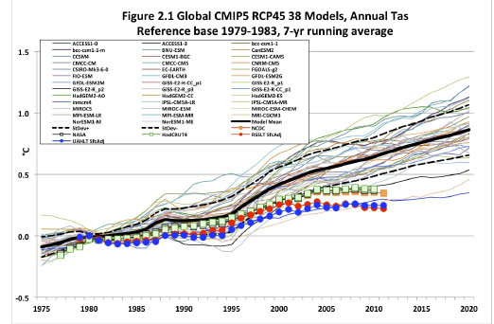
Model Forecasts of Future Global Warming Exceed Actual Results, 1975 - 2012

Slide 71
Sequential Accumulation Plots
Help Track Program Performance
After Clapp and Stibolt, 1991
Notes:
No changes
Note the actual cumulative resource adds are consistently outside the predicted range of outcomes on a cumulative basis. This is a typical result and action should be taken to correct this bias. The estimation process needs to recognize a significant downside not being included in the pre-drill ranges.

Slide 72
Public Regard for Objectivity of Science
Proper role of Advocacy for Scientists?

Slide 73
. . . BACK TO E&P
GEOSCIENCE . . .

Slide 74
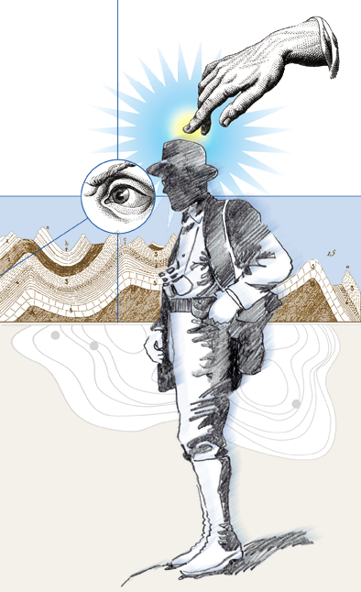
BECAUSE EXPLORATION IS DOMINATED BY
            SUBJECTIVITY
            UNCERTAINTY
              … it invites the Exercise of Intuition!
  . . . so Explorers Tend to Overvalue their Prospects!

Slide 75
PROFESSIONAL RESPONSIBILITIES OF PETROLEUM GEOSCIENTISTS
Find profitable oil and gas accumulations
Measure opportunities consistently w/o bias
Fun Part!
Business Part!

Slide 76

DETACHMENT IS REQUIRED
TO MEASURE
YOUR OWN PROSPECTS!
VISION & INTUITION
Professionalism
Project Teams
MEASUREMENT
W/O BIAS

Slide 77
BASIC MESSAGE:
Q: How to reduce Cognitive Bias in Science?
A: Renewed commitment to the Rigor of the Scientific Method.
REMEMBER RICHARD FEYNMAN!

Slide 78
COGNITIVE BIAS, THE “ELEPHANT IN THE LIVING ROOM” OF SCIENCE AND PROFESSIONALISM
Peter R. Rose, Ph. D
Rose & Associates, LLP
AAPG Distinguished Lecturer, 2015-17

Slide 79
ESSENTIAL READING ON COGNITIVE BIAS:
Daniel Kahneman (2011) Thinking, Fast & Slow.
Massimo Piatelli-Palmarini (1994) Inevitable Illusions: How mistakes of reason rule our minds.
Jonathan Haidt (2013) The Righteous Mind: Why Good People are Divided by Politics & Religion.
Dan Ariely (2012) The (Honest) Truth about Dishonesty: How we lie to everyone – especially ourselves.
Rolf Dobelli (2013) The Art of Thinking Clearly.
Roger Pielke, Jr. (2007) The Honest Broker.
Robert Merton (1957) Reward System of Science.
Thos. Sowell (1996 ed.) Knowledge & Decisions.
Consortium for Science, Policy & Outcomes (2016) Science on the Verge.

